Slide 1
Online masked priming passes the test The effects of prime exposure duration on masked identity priming
Bernhard Angele^{1,2}, Ana Baciero^{2,3},
Pablo Gomez⁴, & Manuel Perea^{2,5}
¹ Bournemouth University, Bournemouth, UK
² Universidad Antonio de Nebrija, Madrid, Spain
³ DePaul University, Chicago, USA
⁴ California State University San Bernardino, Palm Desert Campus, USA
⁵ Universitat de València, Valencia, Spain
Abstract 154

Slide 2
Research is moving online
What if participants can’t or won’t come to the lab?
This is a problem for language researchers.
Solution: Online data collection?
Researchers in many fields have been collecting data onlinefor a while (including language researchers)
For example:
Self-paced reading
RSVP
Lexical decision tasks
But what if we want to do masked priming?

Slide 3
Is (masked) priming possible online?
Overt priming certainly is
Showing nurse before asking Is DOCTOR a word? results in faster and more accurate responses than showing horse.
But masked priming relies on very precise timing of the stimuli.
The prime stimulus needs to be presented very briefly (<60 ms) and is preceded by a pattern mask (e.g., #####).
Due to the mask, participants are unaware of the identity of the masked prime (Forster and Davis 1984; Forster 1998)

Slide 4
Which software to use?
We chose “the three Ps”: Psychopy, Pavlovia, and Prolific
Psychopy (Peirce et al. 2019) is an experiment presentation software allowing precise display of stimuli
It’s written in Python, but there is now the option of translating the experiments into Javascript (PsychoJS) for online presentation.
We chose Psychopy because past studies have reported very accurate timing performance in online studies (Bridges et al. 2020).
Pavlovia is a paid service that integrates with Psychopy and hosts the experiment code and the collected data
Prolific is a participant recruitment service (like Mechanical Turk, but more research-focused and less US-centric)

Slide 5
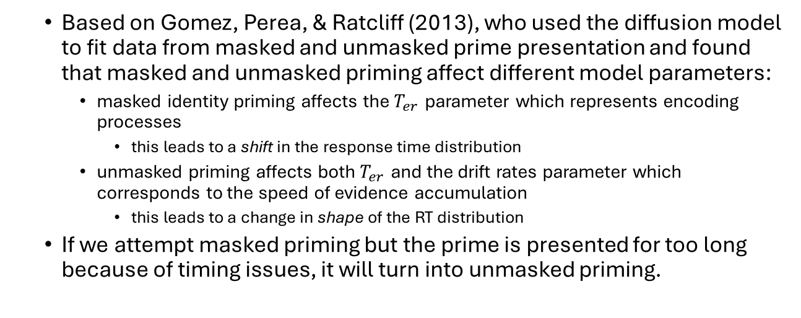
Our study
Based on Gomez, Perea, & Ratcliff (2013), who used the diffusion model to fit data from masked and unmasked prime presentation and found that masked and unmasked priming affect different model parameters:
masked identity priming affects the $T_{er}$ parameter which represents encoding processes
this leads to a shift in the response time distribution
unmasked priming affects both $T_{er}$ and the drift rates parameter which corresponds to the speed of evidence accumulation
this leads to a change in shape of the RT distribution
If we attempt masked priming but the prime is presented for too long because of timing issues, it will turn into unmasked priming.

Slide 6
Rationale
If we can show that results from an online experiment are similar to the masked priming data from Gomez et al. rather than the unmasked priming data, that demonstrates the reliability of the online masked priming paradigm.
Additionally, we can test the accuracy of the timing by manipulating the prime exposure duration:
If we lower the prime exposure duration from 50 ms to 33.3 ms, the size of the priming effect should decrease
Can we present a prime that is short enough (16.6 ms) to not give rise to any priming effect?

Slide 7
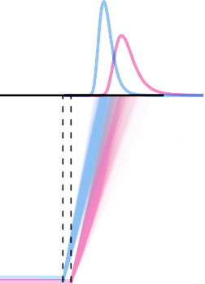
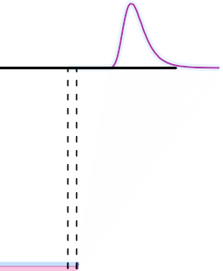
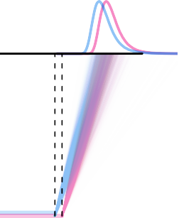
Mapping from hypotheses to data via evidence accumulation models
Null Effect
Effect in Encoding
Effect in Encoding and Evidence Accumulation
Encoding
Evidence accumulation
Encoding
Evidence accumulation
Encoding
Evidence accumulation
0.0
0.4 0.8
RT (sec)
1.2
0.0
0.4 0.8
RT (sec)
1.2
0.0
0.4 0.8
RT (sec)
1.2

Slide 8
Experiment 1: Design
Targets: 240 words and 240 nonwords
Conditions:
prime duration (33 vs. 50 ms)
this corresponds to 2 vs. 3 refresh cycles at 60 Hz
prime condition: identical vs. unrelated
60 word/nonword stimuli per group

Slide 9
Experiment 1: Participants
Participants
77 Prolific participants (41 male, 36 female, mean age: 31.14, ), Range: 18–71).
The experiment was only shown to participants who indicated that English was their first language in the Prolific screening questions.

Slide 10
Experiment 1: Materials
We selected 240 six-letter English words from the English Lexicon Project (Balota et al. 2007). We also selected 240 matched, orthographically legal six-letter nonwords.
For each target, we created an identical prime (e.g. region — REGION and and unrelated prime (launch — REGION).

Slide 11
Experiment 1: Data analysis
We analyzed the data by fitting Bayesian linear and generalized linear mixed models, using the brms package (Bürkner 2017, 2018).
Contrast coding:
Relatedness: identical = -.5; unrelated = .5
Prime exposure duration: 33.3 ms = -.5; 50 ms = .5
Response times modeled using the ex-Gaussian distribution
The mean of the Gaussian component μ and the scale parameter β of the exponential component (equaling the inverse of the rate parameter λ) were both allowed to vary between conditions.
For accuracy, we used a Bernoulli distribution

Slide 12
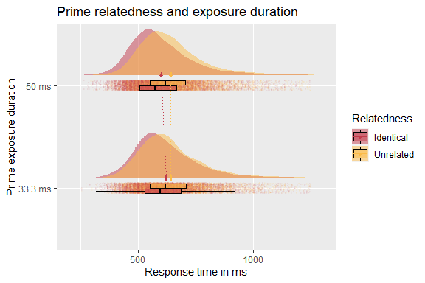
Experiment 1: Results

Slide 13
Experiment 2: Design
Like Experiment 1, but shorter prime duration condition (16 ms vs. 33 ms):
Targets: same 240 words and 240 nonwords
Conditions:
prime duration (16 vs. 33 ms)
this corresponds to 1 vs. 2 refresh cycles at 60 Hz
prime condition: identical vs. unrelated
60 word/nonword stimuli per group

Slide 14
Experiment 2: Participants
Recruited from Prolific
79 participants, aged from 18–69 (mean age: 31.14)
40 male, 39 female)
All participants indicated that English was their first language in the Prolific screening questions.

Slide 15
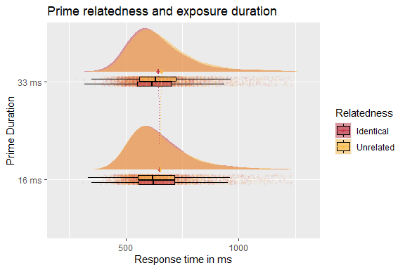
Experiment 2: Results

Slide 16
Discussion
We were able to replicate benchmark masked priming effects:
We observed strong effects of prime relatedness on the mean of the Gaussian component
No or much weaker effects on the shape parameter of the exponential component
The distribution shifts to the right, but does not change its shape.
Just like in laboratory-based studies of masked priming.
This suggests online and laboratory-based studies of masked priming are comparable.

Slide 17
Discussion (2)
We also show that different prime exposure durations lead to different effect sizes:
A prime exposure duration of 50 ms leads to a strong relatedness effect
A prime exposure duration of 33.3 ms leads to a weaker effect
No effect is observed at a prime exposure duration of 16.6 ms
This suggests that prime exposure duration can be accurately manipulated even in an online study

Slide 18
Conclusions
These results give us confidence that the masked priming paradigm can be used in online studies and will produce high-quality data
This opens up new possibilities:
Masked priming studies can be conducted remotely
In times when participants cannot come to the lab
For populations who are far away from the lab
For crowdsourcing megastudies across countries/languages/cultures.

Slide 19
Thank you!

Slide 20
Thank you!
Balota, David A., Melvin J. Yap, Keith A. Hutchison, Michael J. Cortese, Brett Kessler, Bjorn Loftis, James H. Neely, Douglas L. Nelson, Greg B. Simpson, and Rebecca Treiman. 2007. “The English Lexicon Project.” Behavior Research Methods 39 (3): 445–59. https://doi.org/10.3758/BF03193014.
Bridges, David, Alain Pitiot, Michael R. MacAskill, and Jonathan W. Peirce. 2020. “The Timing Mega-Study: Comparing a Range of Experiment Generators, Both Lab-Based and Online.” PeerJ 8 (July): e9414. https://doi.org/10.7717/peerj.9414.
Bürkner, Paul-Christian. 2017. “brms: An R Package for Bayesian Multilevel Models Using Stan.” Journal of Statistical Software 80 (1): 1–28. https://doi.org/10.18637/jss.v080.i01.
———. 2018. “Advanced Bayesian Multilevel Modeling with the R Package brms.” The R Journal 10 (1): 395–411. https://doi.org/10.32614/RJ-2018-017.
Forster, Kenneth. 1998. “The Pros and Cons of Masked Priming.” Journal of Psycholinguistic Research 27 (2): 203–33.
Forster, Kenneth, and Chris Davis. 1984. “Repetition Priming and Frequency Attenuation in Lexical Access.” Journal of Experimental Psychology: Learning, Memory, and Cognition 10 (4): 680–98. https://doi.org/10.1037/0278-7393.10.4.680.
Peirce, Jonathan, Jeremy R. Gray, Sol Simpson, Michael MacAskill, Richard Höchenberger, Hiroyuki Sogo, Erik Kastman, and Jonas Kristoffer Lindeløv. 2019. “PsychoPy2: Experiments in Behavior Made Easy.” Behavior Research Methods 51 (1): 195–203. https://doi.org/10.3758/s13428-018-01193-y.

Slide 21
Experiment 1: Results
Stimulus Type | Prime Duration | Relatedness | Mean | Median | SD | Min | Max | Accuracy
Nonword | 33.3 ms | Identity | 700 | 664 | 189 | 263 | 1,885 | 0.91
Nonword | 33.3 ms | Unrelated | 704 | 664 | 194 | 256 | 1,949 | 0.92
Nonword | 50 ms | Identity | 699 | 657 | 191 | 256 | 1,938 | 0.91
Nonword | 50 ms | Unrelated | 700 | 656 | 192 | 251 | 1,952 | 0.93
Word | 33.3 ms | Identity | 630 | 598 | 168 | 254 | 1,942 | 0.94
Word | 33.3 ms | Unrelated | 652 | 618 | 170 | 254 | 1,887 | 0.93
Word | 50 ms | Identity | 608 | 574 | 161 | 265 | 1,866 | 0.96
Word | 50 ms | Unrelated | 648 | 619 | 158 | 294 | 1,801 | 0.93

Slide 22
Experiment 1: Bayesian LMM results
Parameter | mean | SE | lower bound | upper bound | R_Hat
Intercept (µ) | 633.620 | 6.504 | 620.936 | 646.430 | 1.009
Intercept (ß) | 4.669 | 0.031 | 4.607 | 4.729 | 1.003
Relatedness (µ) | 31.353 | 1.878 | 27.659 | 35.006 | 1.001
Prime Duration (µ) | -11.382 | 1.704 | -14.746 | -8.018 | 1.001
Relatedness:Prime Duration (µ) | 19.309 | 3.699 | 12.141 | 26.455 | 1.000
Relatedness (ß) | 0.032 | 0.020 | -0.007 | 0.070 | 1.000
Prime Duration (ß) | -0.081 | 0.022 | -0.124 | -0.038 | 1.000
Relatedness:Prime Duration (ß) | 0.029 | 0.041 | -0.052 | 0.110 | 1.000

Slide 23
Experiment 1: Bayesian LMM results (accuracy)
Parameter | mean | SE | lower bound | upper bound | R_hat
Intercept | 3.451 | 0.122 | 3.217 | 3.695 | 1.000
Relatedness | -0.496 | 0.105 | -0.714 | -0.301 | 1.000
Prime Duration | 0.195 | 0.109 | -0.012 | 0.417 | 1.000
Relatedness:Prime Duration | -0.533 | 0.204 | -0.943 | -0.145 | 1.000

Slide 24
Experiment 2: Results
Stimulus Type | Prime Duration | Relatedness | Mean | Median | SD | Min | Max | Accuracy
Nonword | 16 ms | Identical | 721 | 680 | 191 | 330 | 1,929 | 0.93
Nonword | 16 ms | Unrelated | 719 | 677 | 187 | 284 | 1,920 | 0.94
Nonword | 33 ms | Identical | 719 | 668 | 198 | 351 | 1,924 | 0.94
Nonword | 33 ms | Unrelated | 718 | 672 | 197 | 281 | 1,912 | 0.94
Word | 16 ms | Identical | 660 | 625 | 162 | 311 | 1,892 | 0.94
Word | 16 ms | Unrelated | 662 | 623 | 169 | 308 | 1,899 | 0.95
Word | 33 ms | Identical | 650 | 618 | 158 | 280 | 1,873 | 0.96
Word | 33 ms | Unrelated | 667 | 633 | 164 | 269 | 1,920 | 0.94

Slide 25
Experiment 2: Bayesian LMM results
Parameter | mean | SE | lower bound | upper bound | R_Hat
Intercept (µ) | 658.462 | 9.372 | 640.004 | 676.606 | 1.002
Intercept (ß) | 4.668 | 0.042 | 4.585 | 4.749 | 1.005
Relatedness (µ) | 8.799 | 1.758 | 5.420 | 12.286 | 1.000
Prime Duration (µ) | -3.481 | 1.841 | -7.095 | 0.161 | 1.000
Relatedness:Prime Duration (µ) | 15.347 | 3.425 | 8.639 | 22.046 | 1.000
Relatedness (ß) | 0.031 | 0.023 | -0.013 | 0.076 | 1.000
Prime Duration (ß) | 0.013 | 0.022 | -0.030 | 0.055 | 1.000
Relatedness:Prime Duration (ß) | -0.030 | 0.043 | -0.116 | 0.055 | 1.000

Slide 26
Experiment 2: Bayesian LMM results (accuracy)
Parameter | mean | SE | lower bound | upper bound | R_hat
Intercept | 3.736 | 0.135 | 3.475 | 4.007 | 1.000
Relatedness | -0.218 | 0.109 | -0.434 | -0.004 | 1.000
Prime Duration | -0.054 | 0.126 | -0.313 | 0.183 | 1.000
Relatedness:Prime Duration | -0.708 | 0.219 | -1.165 | -0.302 | 1.000

